Slide 1
Hamster Homebound
Game Design
By: Beau Brechtel, Kaidon Eccles, Nicholas Schroeder, Sharmin Zaman, Nathan Evans
Notes:
Hi everyone, we’re Group 2, and this is our game, Hamster Homebound. My name is _____, and I’m here with [others names] to walk you through our project

Slide 2
What is Hamster Homebound?
Premise
a lost hamster journeys through dangerous, puzzle-filled levels to rescue his captured family
Players navigate obstacles, avoid enemies, and collect keys and power-ups to progress and ultimately reunite the hamster with his family
Genre
2D Platformer, Adventure
Premise
Genre

Slide 3
Details (.README)
Goal: Use three golden keys gained through levels 1-3 to open the cage holding Milton’s brothers: Let and Burg
Controls: Milton can move left/right with arrow keys, jump and double jump with the spacebar
Screens: title, next level, game over, level select
3 Levels
Episode 1: Breaking Bad - essentially a tutorial level that guides player through basic controls with a little speech block thing that provides exposition (text block object is shown in videos 79-80) and introduces them to the objects, obstacles, checkpoints and story (Scene > Testing2 in Unity)
Episode 2: Malcolm in the Middle - Malcolm in the Middle - medium difficulty level to test some player skills (Scene > Testing in Unity)
Episode 3: Arrested Development - defeat big snake use golden keys to save Milton’s family, brothers Let and Burg (get it?) who look exactly like Milton but have a different secondary fur color, from cage

Slide 4
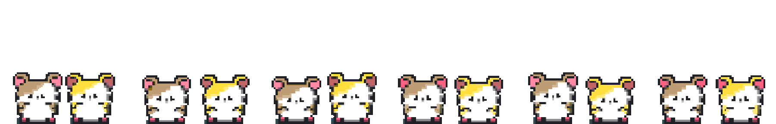
Meet the Ham Fam
Milton
Let
Burg
Milton is the youngest of 3 siblings. He is energetic, playful, and very brave. He enjoys pears and dislikes frogs
Let is the oldest of his siblings. He is earnest, kind, and a great caretaker
Burg is the middle child. He is often overlooked by their parents. He is quiet and reserved.
Notes:
Characters: Milton (Player), Brothers: Let & Burg

Slide 5


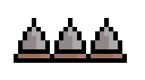
Enemies & Obstacles
Frog
Eagle
Spikes
Common Enemy, present in early levels. Can defeat by double jumping on top of it
Boss Enemy. Present in Level 3. Swoops down to attack. Should be dodged
Damages player health by ½ when player runs into it. Can avoid by jumping over.
Notes:
Enemies: Snake, Big Snake changed to -> Frog and Hawk
Obstacles: spikes, moving platform

Slide 6



Pickups
Star
Key
Pear
Collectible item. Increases player score when picked up.
Required item. 3 needed to unlock the cage at the end of the game.
Health item. Restores player health when collected.
Notes:
Collectibles: golden key for final cage unlock (in the tutorial this would be the gems; the amount of these you collect show up in the upper right hand corner of the screen as you collect them); pear for restoring a half life (tutorial version: cherries). Optional: stars to collect for the level score

Slide 7


Development Environment
Unity
Git
We chose Unity as our development environment because we have gained experience using it throughout this course, making it a familiar and efficient tool for our team. We also believe the strong support Unity provides for 2D game development will make it simpler and easier for us to build our game. This will allow us to develop Hamster Homebound quickly and effectively.
We also used GitHub for version control so our team can collaborate, work on the project at the same time, and keep our code and assets organized. We made separate branches for each member to add their changes to. We added a branch protection rule to main and made it so that each individuals changes would have to be reviewed by two peers before it could be pushed to main.

Slide 8

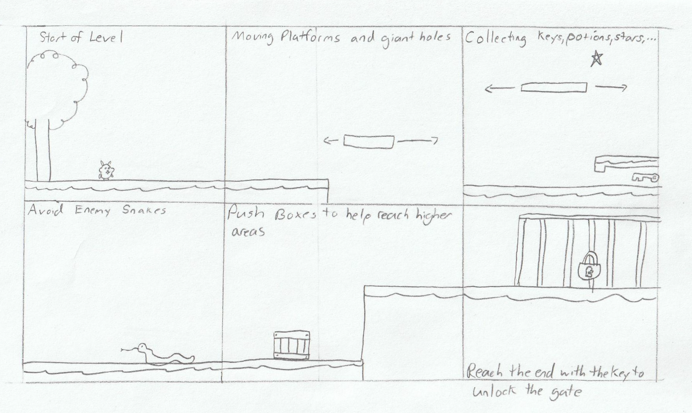
Storyboard

Slide 9
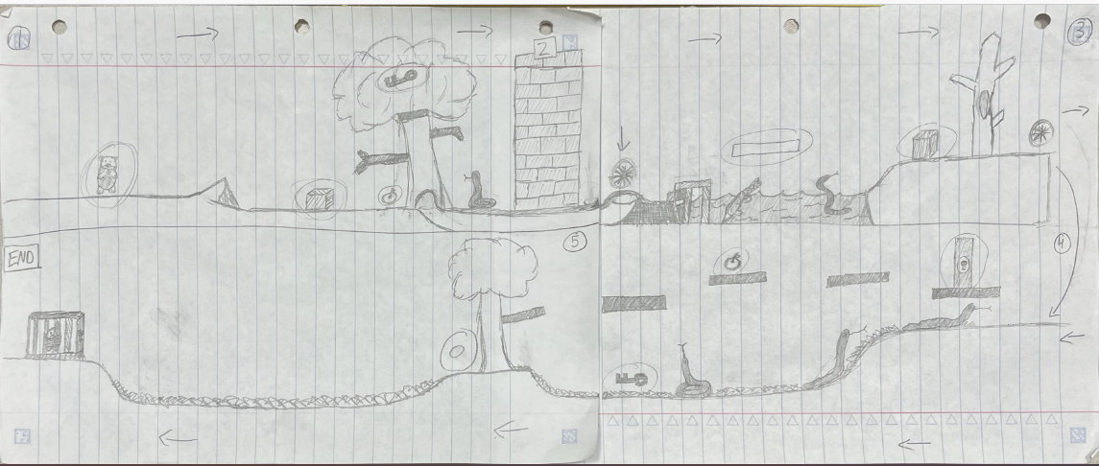
Planned Level Designs

Slide 10
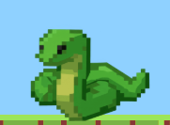
Changes to original game design
Character name changed from Hammy to Milton
Changed enemies from Snake and Big Snake to Frog and Hawk
Opted not to implement red key
Changed level design from planned blueprint
I’ve been replased

Slide 11
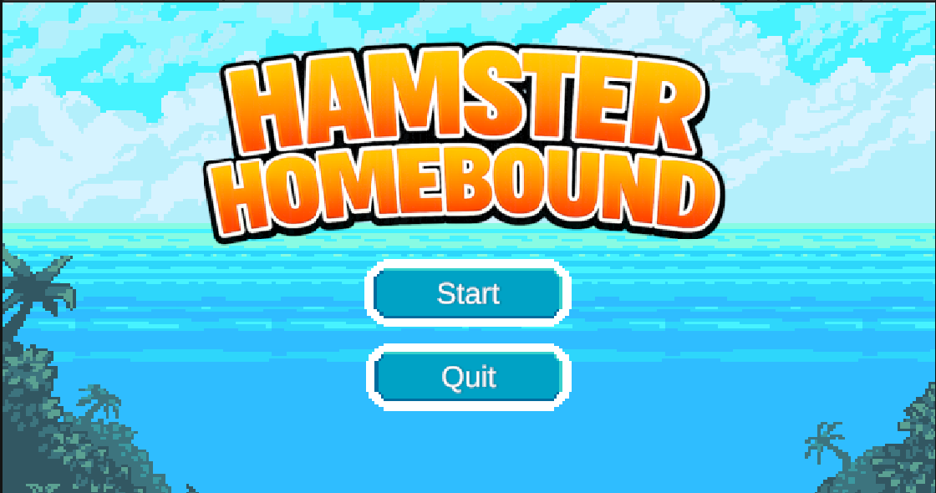
Scenes: Main Menu

Slide 12
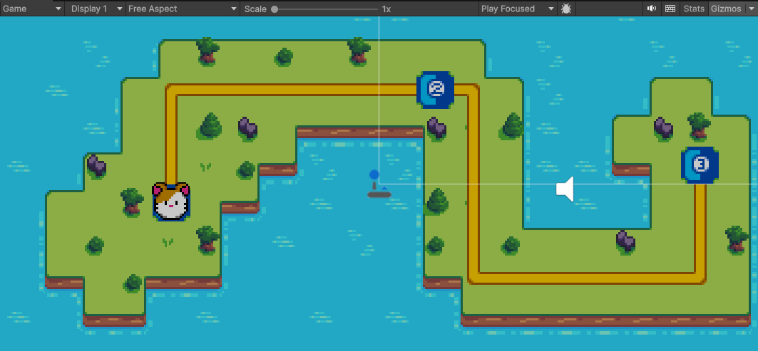
Scenes: Level Select

Slide 13
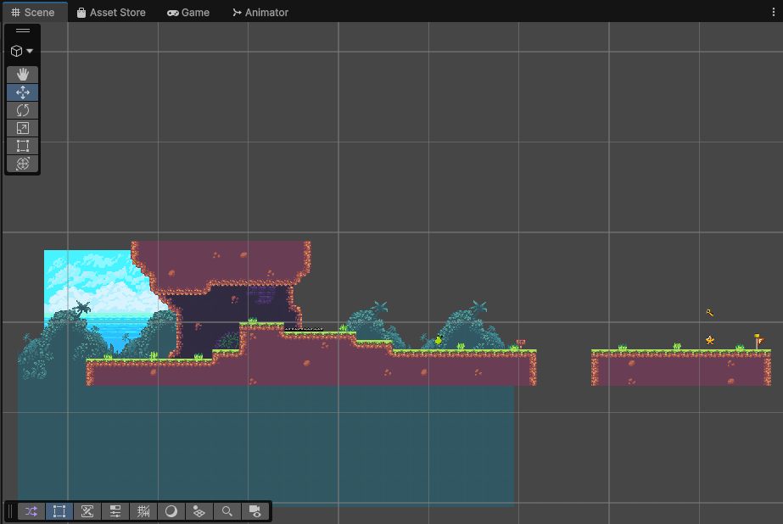
Scenes: Level 1

Slide 14
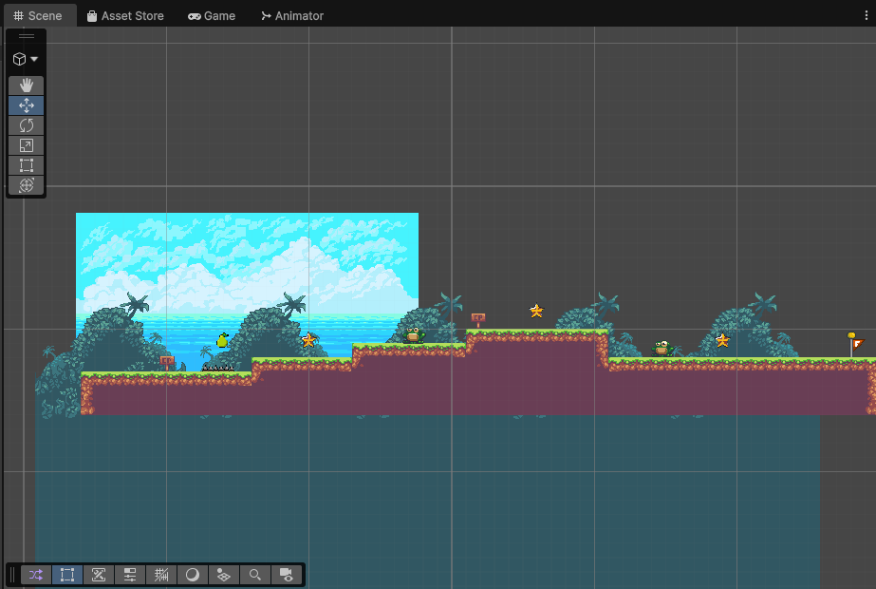
Scenes: Level 2
Notes:
Enemies: Snake, Big Snake changed to -> Frog and Hawk
Obstacles: spikes, moving platform

Slide 15
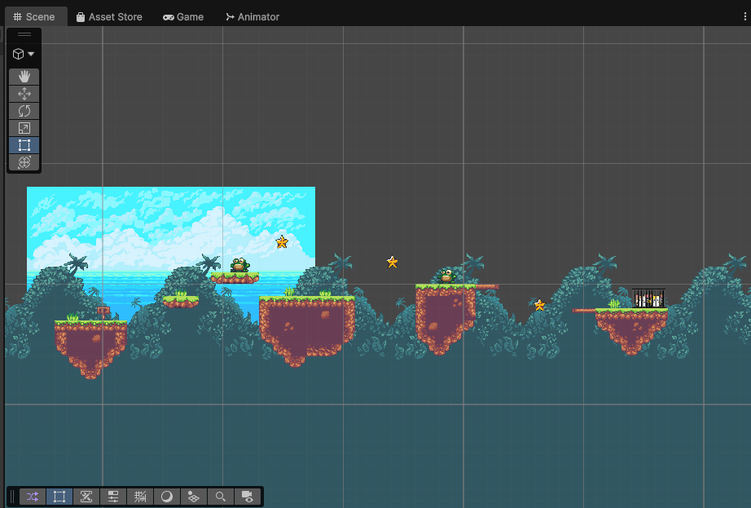
Scenes: Level 3
Notes:
Enemies: Snake, Big Snake changed to -> Frog and Hawk
Obstacles: spikes, moving platform

Slide 16
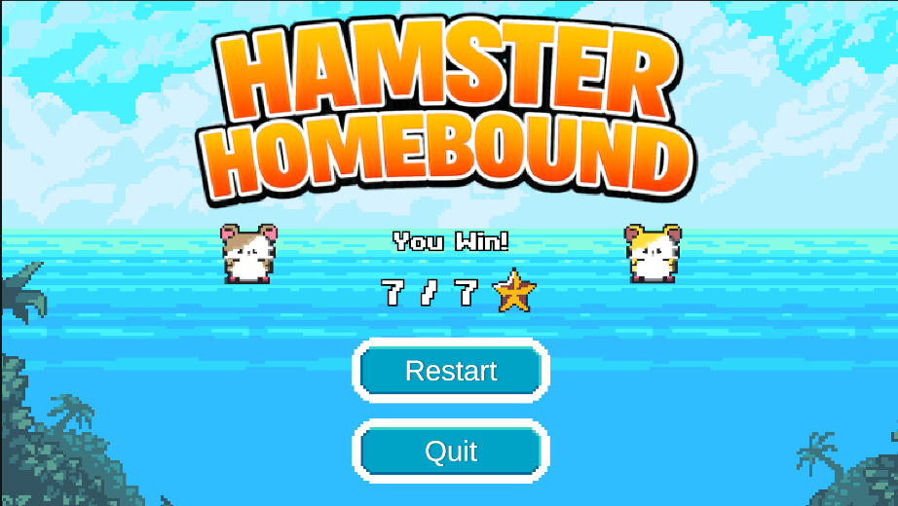
Scenes: Ending
Notes:
Enemies: Snake, Big Snake changed to -> Frog and Hawk
Obstacles: spikes, moving platform

Slide 17

Character Animations - 1
Milton_idle
Milton_running
Milton_hurt
Notes:
Enemies: Snake, Big Snake changed to -> Frog and Hawk
Obstacles: spikes, moving platform

Slide 18
Character Animations - 2
Family_caged_idle
Family_breakout_1
Family_freed
Family_breakout_2 (freed)
Notes:
Enemies: Snake, Big Snake changed to -> Frog and Hawk
Obstacles: spikes, moving platform

Slide 19
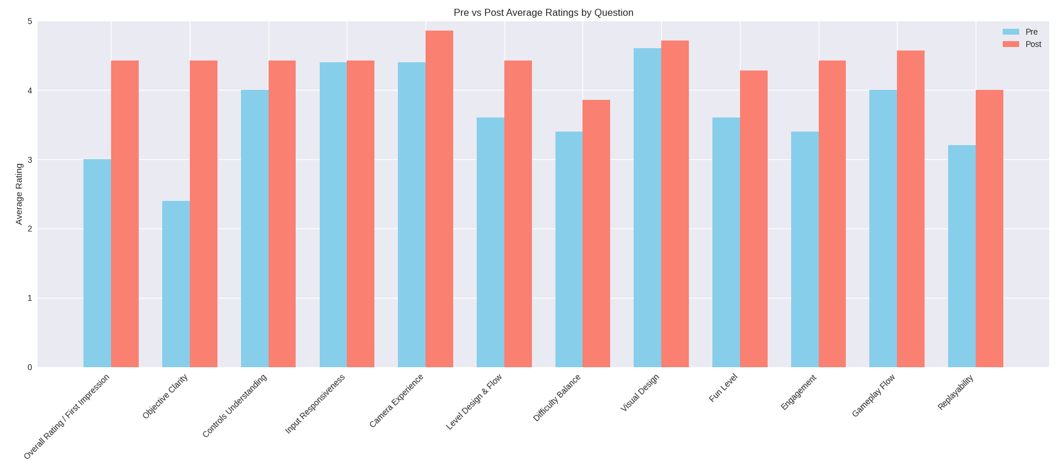
Testing: Questionnaires

Slide 20
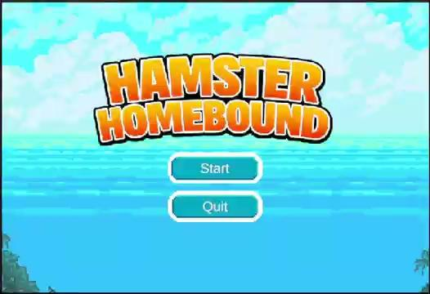
Final Product: Demo Video

Slide 21
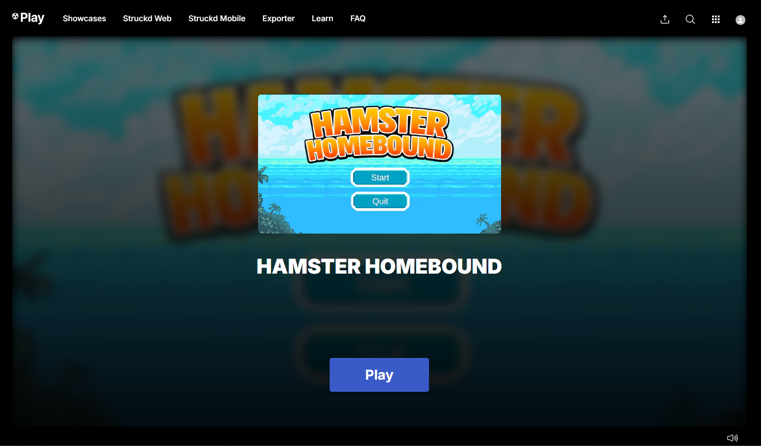
Try it out!
Hosted in Unity Play
https://play.unity.com/en/games/fd48e121-d87b-4d57-926d-057db749b4f1/hamster-homebound
Best experienced with Browser set to 80% Zoom

Slide 22
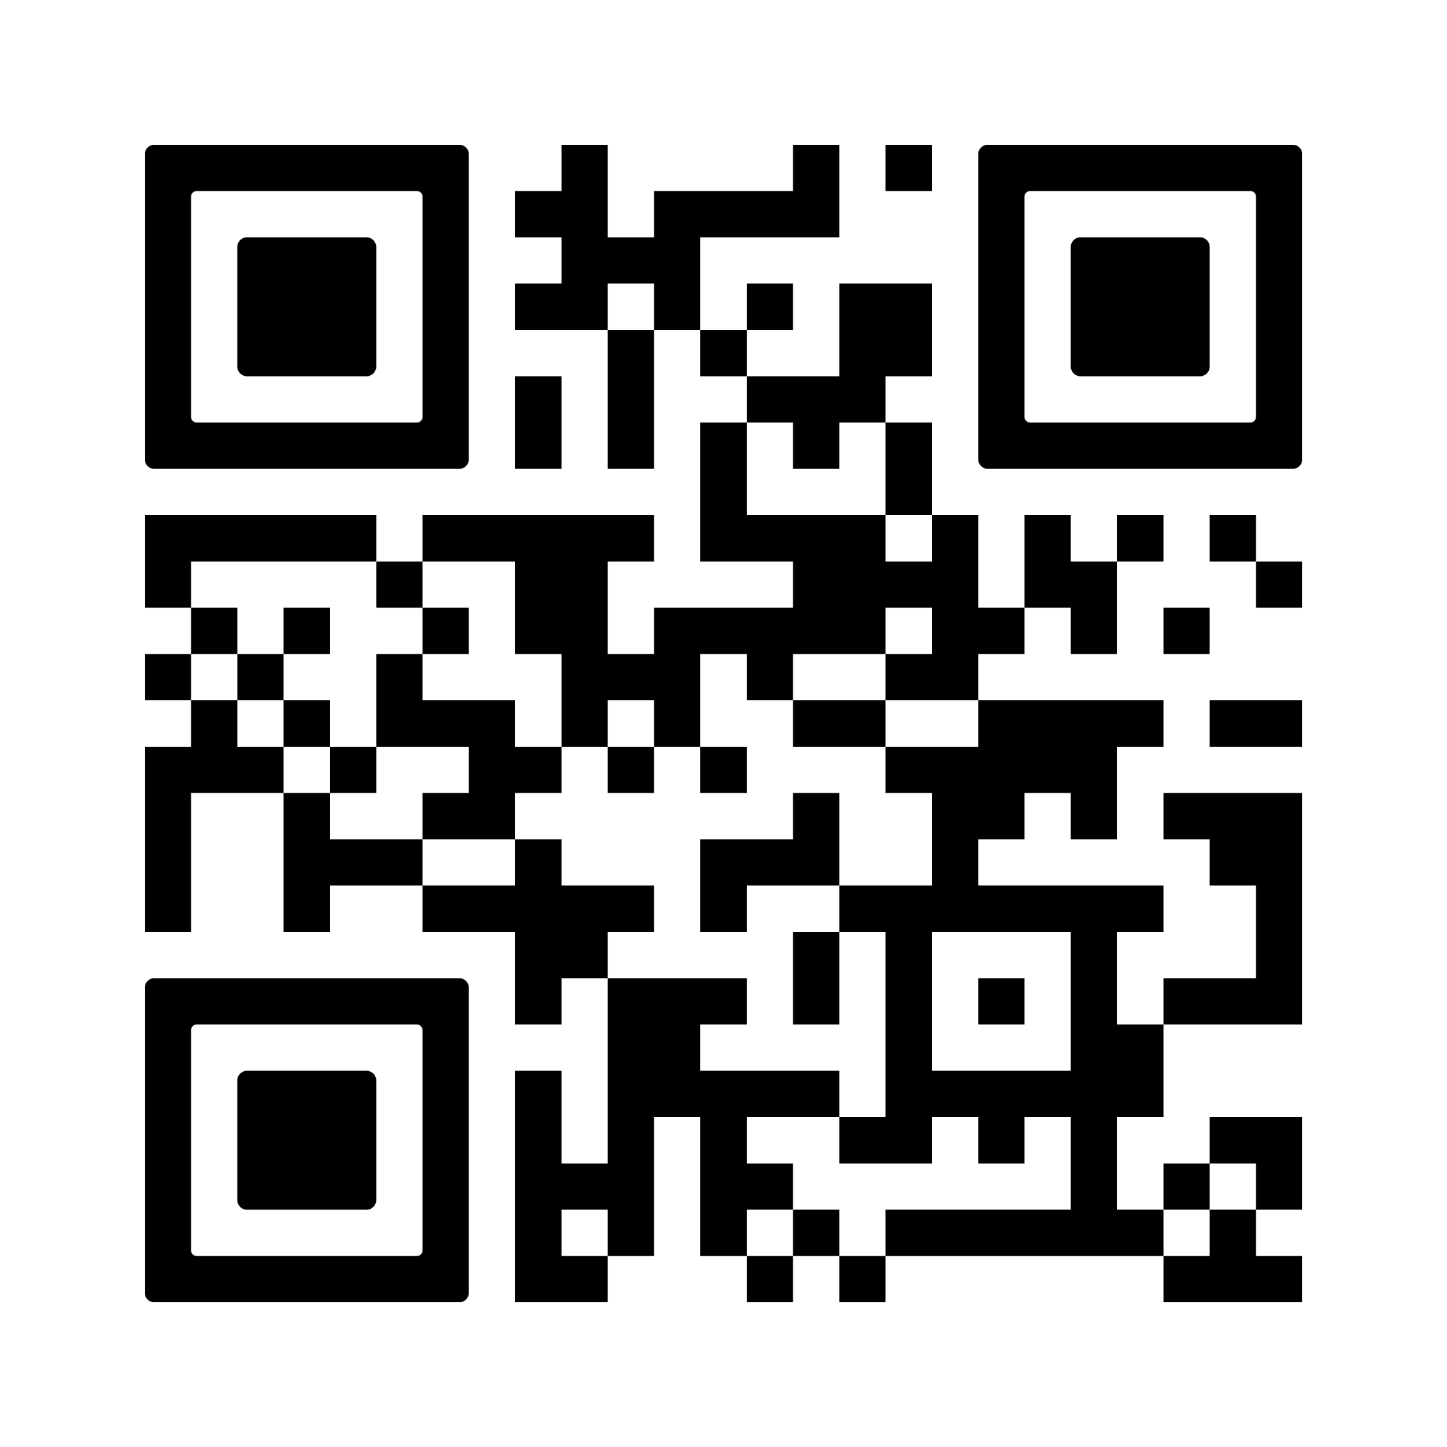
Let us know your thoughts!
Scan the code to access our post-questionnaire

Slide 23
Questions?

Slide 24
Thank you!!

